Slide 1
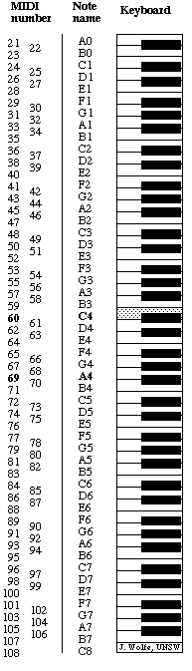
Converting MIDI file information into vector file for plotter/cutter production of piano roll – Version 1.2
This gets turned 90 counterclockwise so note A0 (MIDI note 21)
is at the left and C8 (MIDI 108) is at the right of the image, just like the piano.
Paper moves down when playing
286mm
Loud
Pedal
Note Space
11
mm
A0
21
1.44 mm (all notes have equal width)
C8
108
30 seconds
=
1070 mm
@ Tempo 70
1.55
mm
Long notes ( more than 17 mm long on the roll or roughly 1/2 second long) need to be cut differently to prevent tears.
An initial section of roughly 8 5 mm with subsequent 1.52 4mm squares with 0.8mm spaces between them with a final opening of 8 5 mm to close the note. This way the vacuum stays broken through the whole length and prevent the two side from tearing apart.
Edge of paper
1.44 mm (all spaces have equal width)
1.37 mm
Edge of paper
15.2 mm
18.6 mm
21.5 mm
252.2 mm
245.9 mm
Cut openings on piano roll

Slide 2
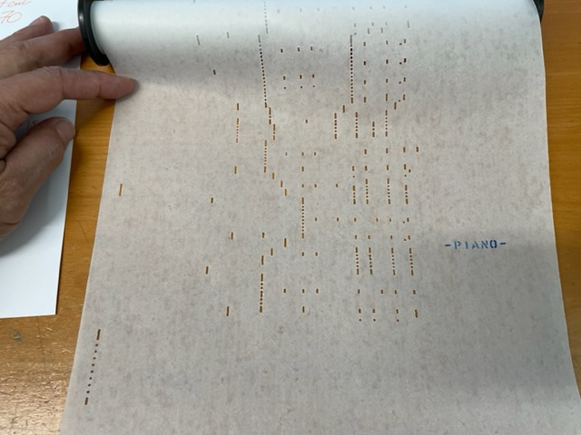
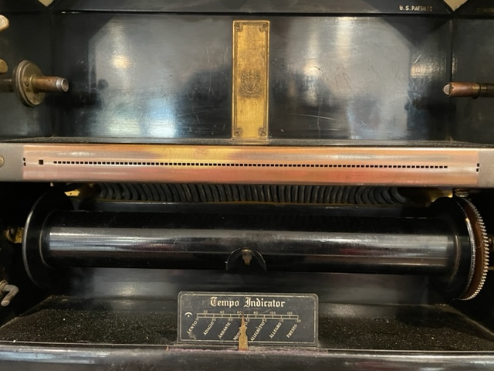
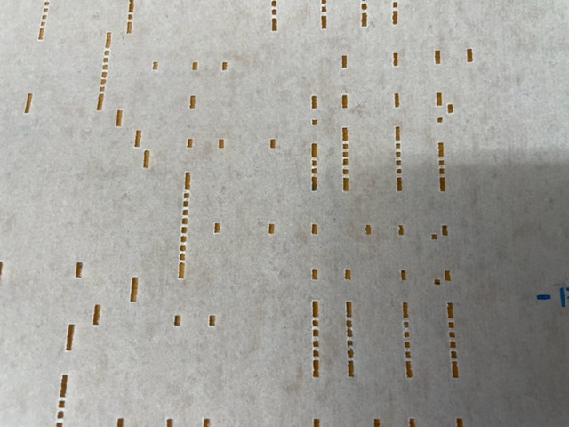

Slide 3
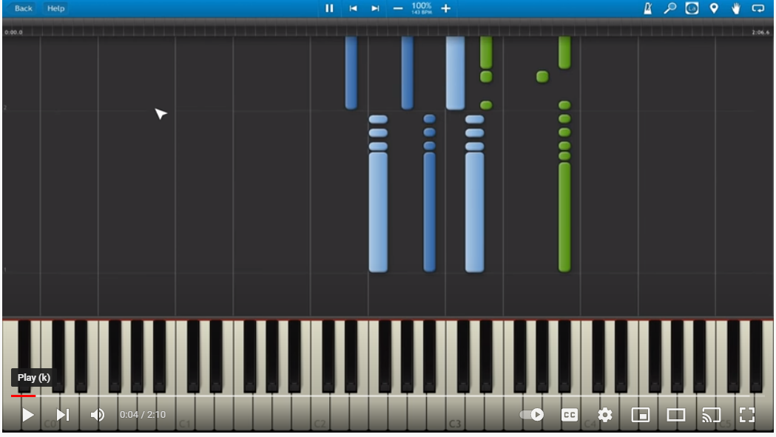
To 108
53
58
62
70
21
24
36
48
60
72
94
98

